Slide 1


CM1606: Computational Mathematics
Data Analysis (contd.)
Week 02 | Prashan Rathnayaka (prashan.r@iit.ac.lk)

Slide 2
Boxplot
This graphical tool is a quick way to visualize the 5-number summary
(i.e. Min, Q1, m, Q3, Max)
A Boxplot reveals the shape of the distribution (whether symmetric, left-skewed, or right-skewed), and shows possible outliers.

Slide 3
Frequency Tables and Histograms
A frequency table shows a count of data values that fall into a set of
non-overlapping bins (of the same size).
The histogram displays this information with the bins (without gaps) on the x-axis and counts ( or fractions) on the y-axis.
A gap can occur only if a bin is empty.

Slide 4
Density Estimates (Density Plot)
Density plot: smoothed histogram showing the shape of the distribution of data as a smooth curve. Meaningful for large datasets.
One can visualize this as a smoothed ‘frequency polygon’ for a histogram of relative frequencies.
A ‘frequency polygon’ is a plot obtained by joining the mid-points of the upper side of each bar.

Slide 5
Mode
The mode is the value (values in case of a tie) that appears most often in the data. For example,
In most parts of the United States, the mode for religious preference would be Christian.
The mode is a simple summary statistic for categorical data, and it is generally not used for numeric data.

Slide 6
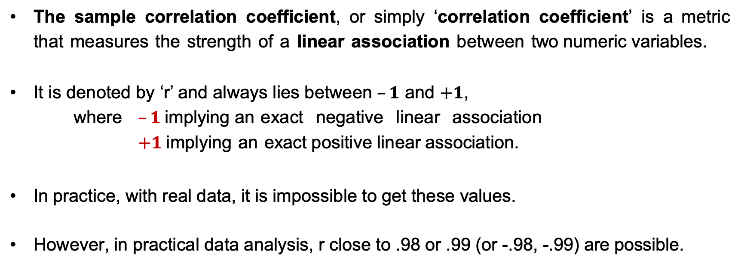
Correlation Coefficient
The sample correlation coefficient, or simply ‘correlation coefficient’ is a metric that measures the strength of a linear association between two numeric variables.
It is denoted by ‘r’ and always lies between $–1$ and $+1$,
where $–1$implying an exact negative linear association
$+1$implying an exact positive linear association.
In practice, with real data, it is impossible to get these values.
However, in practical data analysis, r close to .98 or .99 (or -.98, -.99) are possible.

Slide 7
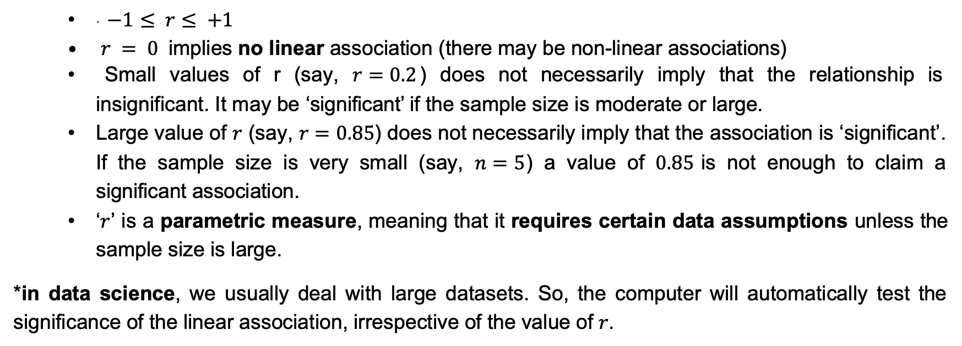
Properties of ‘r’ (= Pearson’s Correlation Coefficient)
· $−1≤ r≤ +1$
$r = 0$implies no linear association (there may be non-linear associations)
Small values of r (say, $r=0.2$) does not necessarily imply that the relationship is insignificant. It may be ‘significant’ if the sample size is moderate or large.
Large value of $r$ (say, $r=0.85$) does not necessarily imply that the association is ‘significant’. If the sample size is very small (say, $n=5$) a value of $0.85$is not enough to claim a significant association.
‘$r$’ is a parametric measure, meaning that it requires certain data assumptions unless the sample size is large.
*in data science, we usually deal with large datasets. So, the computer will automatically test the significance of the linear association, irrespective of the value of $r$.

Slide 8
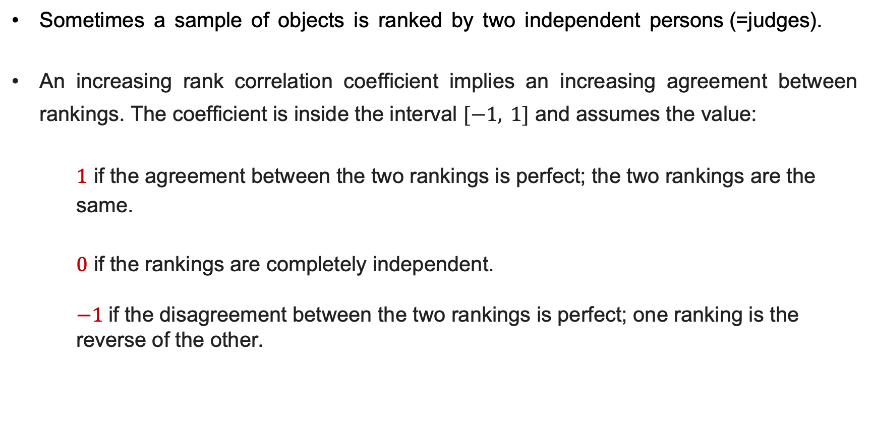
Rank Correlation (Spearman’s Correlation)
Sometimes a sample of objects is ranked by two independent persons (=judges).
An increasing rank correlation coefficient implies an increasing agreement between rankings. The coefficient is inside the interval $[−1, 1]$ and assumes the value:
$1$ if the agreement between the two rankings is perfect; the two rankings are the same.
$0$ if the rankings are completely independent.
$−1$if the disagreement between the two rankings is perfect; one ranking is the reverse of the other.

Slide 9
Exploring two (or more) variables
· For plotting numeric vs numeric data, most common tool is the ‘scatterplot’
Hexagonal binning and contour plot are alternatives to scatterplot, with large datasets. [See Bruce and Bruce, pp 36-37]
Contingency table is a table that shows associations between two categorical variables.

Slide 10
Contingency Table
A contingency table shows counts for each combination of two categorical variables with ‘R’ levels and ‘C’ levels respectively.
It is called an ‘R x C contingency table’.
The objective is to test if the two variables are independent.
The ‘test of independence’ is carried out using a ‘chi-square test of independence’.
We compute the value for ‘chi-square statistic’ from data and compare it with a tabulated value based on (R-1)(C-1) degrees of freedom and a required level of ‘significance’(standard level is 5% (= .05)).
If the computed value is greater than the table value, we reject
independence and conclude that there is a significant between the two variables.
association
20

